Slide 1
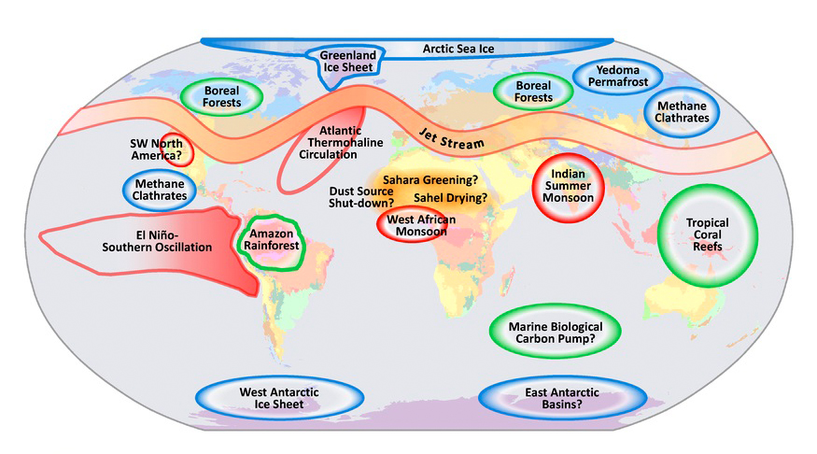
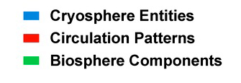

Slide 2
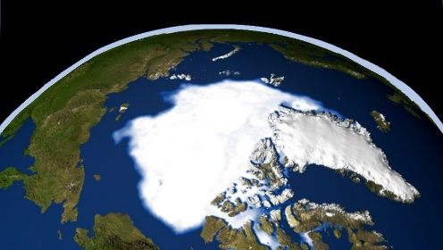
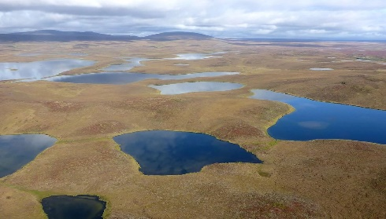
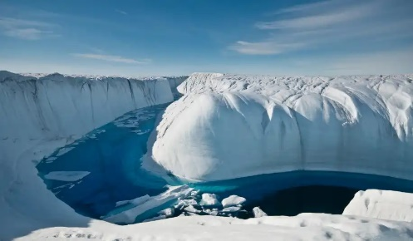
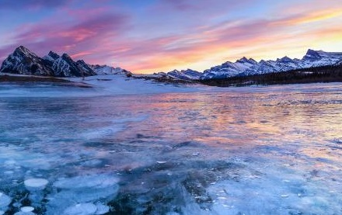
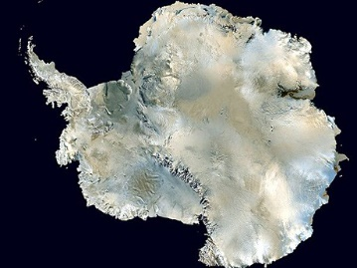
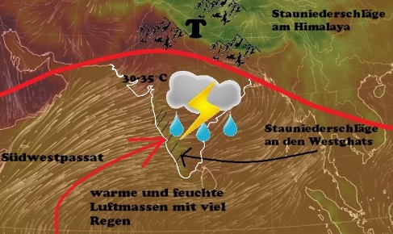
Ice - Arctis
Albedo
Ice Permafrost
Methane hydrate
The reflectivity of surfaces is called Albedo α and is particularly high in ice. The white surfaces of the earth reflect 30% of solar radiation! What effect does global warming have on them? Is there feedback and what do they cause?
In the permafrost regions, large quantities of methane are stored in crystal form, so-called methane hydrates. At higher temperatures it decays and the methane (a powerful greenhouse gas) is released into the atmosphere. Where are these areas and are there feedback effects?
Methane
Ice - Greenland
Ice melting in the north
Lakes- Only ice?
Stored methane
As temperatures rise, the entire ice sheet on land becomes unstable and slides into the sea. A lubricating film forms at the bottom of the ice sheet, which grows due to meltwater. Where on earth does this happen? And is there feedback? What kind of feedback?
Large quantities of methane hydrates are stored at the bottom of seas and lakes. At higher temperatures it decomposes and methane (a powerful greenhouse gas) is released into the atmosphere. Where are these areas and are there feedback effects?
Ice - Antarctica
Ice melting in the south
Indian monsoon
Floods
As temperatures rise, the entire ice sheet on land becomes unstable, but the ice on the sea also disappears. The mainland glaciers then slide unchecked into the sea. Where does this happen on earth? And is there feedback here?
In summer the air above this part
in the world up to 50 °C hot. As the air rises
a low-pressure system is formed which attracts humid air from the ocean. This air flows over land and rains heavily. What happens when it gets warmer? Is there feedback here?

Slide 3
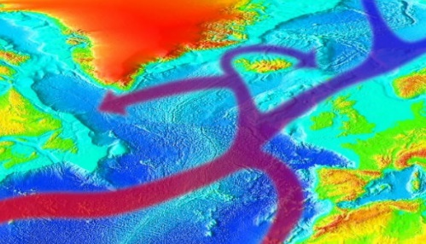
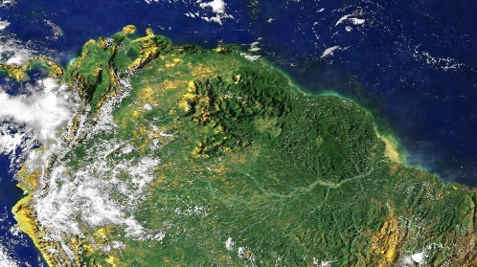
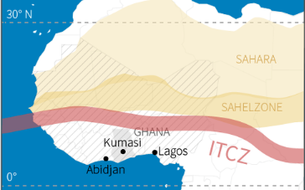
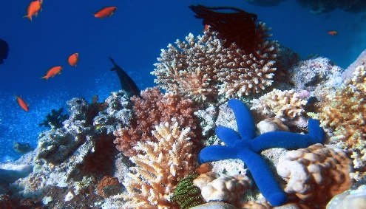
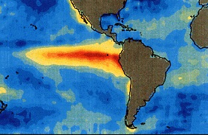
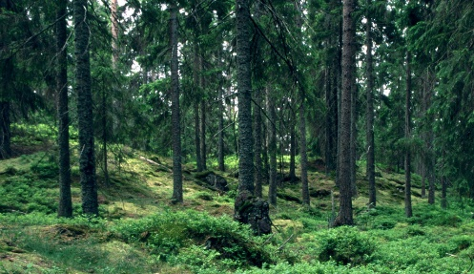
Atlantic Circulation
Too much sweet water
Amazon Rainforest
The lungs of the world
Water currents in the North Atlantic are caused by differences in water temperature and salt concentration. Denser water sinks. The melting of ice on Greenland changes the salt concentration of the water. What happens then?
The tropical rainforests are buffers in the earth's climate system. Plants absorb CO2 and store it as biomass. Most of the rainfall comes from water evaporated above the forest. The Amazon is burning due to global warming and deforestation. What happens then?
West Africa Monsoon
Humid air from the Atlantic
Tropical coral reefs
Colours that fade
In West Africa, the hot air rises rapidly, creating a low-pressure system. Humid air flows from the Atlantic and rains heavily over the mainland. The Sahel could become drier or greener, depending on the situation. What does this mean for the population?
The coral reefs formed by cnidarians in the sea, form unique Ecosystems with an almost infinite variety of animal and plant species. At the same time, coral reefs contribute to the food supply of millions of people. What happens to them as a result of climate change?
El Niño
Pacific Current
Boreal forests
Protective Greens
In the case of El Nino, the sea surface in the equatorial Pacific heats up more than normal. This causes heat in Australia, South East Asia and South Africa. The rain that is missing there falls abundantly over the west coast of South America. What happens when the equator gets warmer?
The effects of climate change in the boreal forests are devastating. It is too warm and too dry. Infestation by insect pests, strong storms and fires are killing the forests. Deforestation would give them the rest. Are there feedback effects?

Slide 4
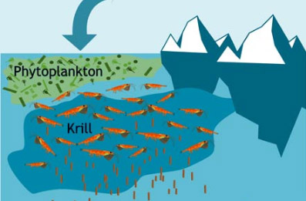
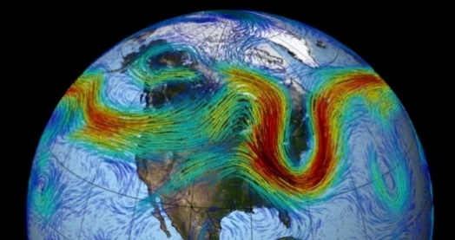
Marine carbon pump
Gelagerte CO2
CO2
Plankton at the surface of the oceans absorbs CO2. Krill eats the plankton and deposits the CO2 on the seafloor through the excretions. What happens to the plankton when the water gets warmer? Are there feedback processes?
stored CO2
Jet streams
Air currents in the north
The jet stream winds its way around the northern hemisphere at an altitude of 7 to 12 kilometres. It separates the cold air of the north from the warmer south. It is now so slow that major weather situations such as cold and heat waves, floods and droughts do not disappear for many weeks.

